Slide 1
Stock Market Analysis
Zach Herington, Molly Oesterling, Tomorrow Rose, Chris Waycott

Slide 2
Our Data
Historical stock price data for technology stocks
New York Stock Exchange (NYSE) | London Stock Exchange (LSE) | Over the Counter Markets (OTCMKTS)
Apple (AAPL) | Sage Group (SGE.L) | Infineon Technologies (IFNNY)
Microsoft (MSFT) | Vodafone Group (VOD.L) | Aac Technologies Holdings (AACAF)
Google (GOOG) | Micro Focus International (MCRO) | Techtronic Industries (TTNDF)

Slide 3
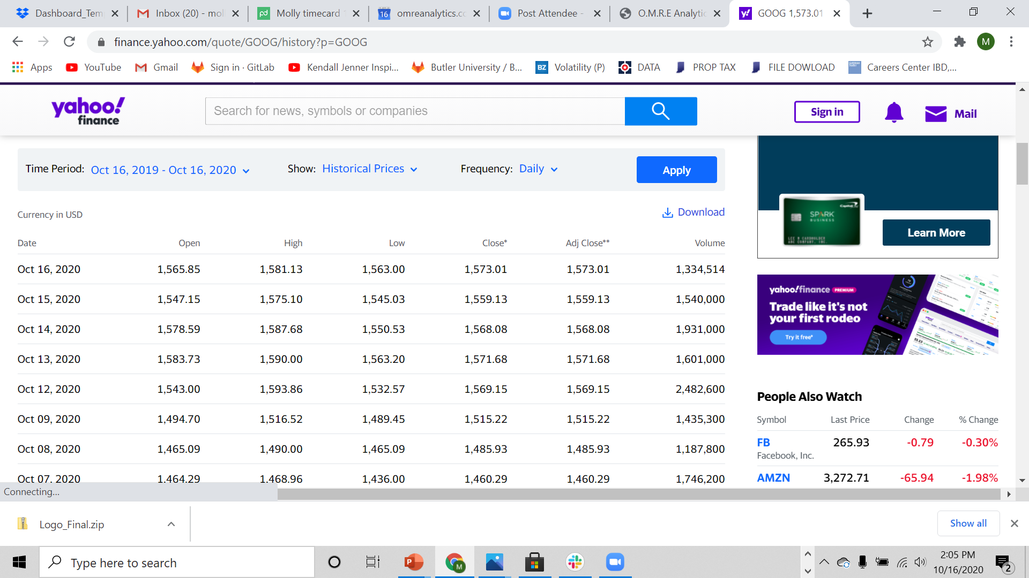
Data Source
Yahoo Finance Historical Stock Market Data

Slide 4
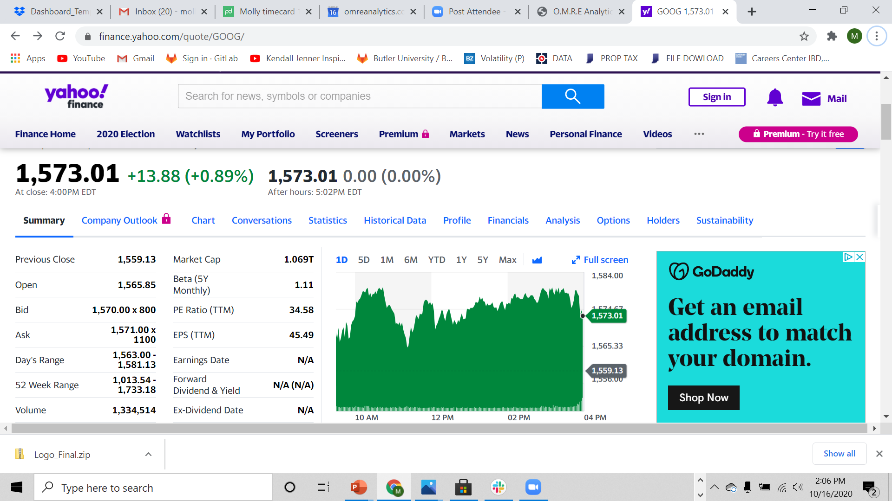
Data Visuals Inspiration

Slide 5
Project Overview
Database – MongoDB
Class - Dashboard with multiple charts that update from the same data
New JS Library – Chart.js
Over 100 Records – Yes
User Driven Interface – Drop down selection to choose a stock from each stock exchange
Three Views – Yes. One for a given stock on each of the three stock exchanges

Slide 6
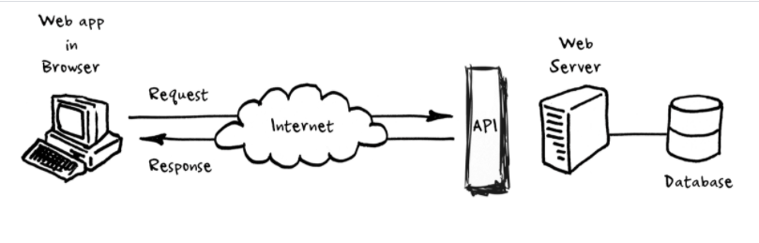
Our Process
Obtain historical stock market data from Yahoo Finance
Convert multiple CSV files into one
Use Python to send CSV data to MONGO database
Use Flask to create RESTful API
Use JavaScript, D3, plotly, and Chart.js to manipulate and plot the data
Use HTML and CSS to display visualizations
Use Atlas to deploy our database, and Heroku to deploy application

Slide 7
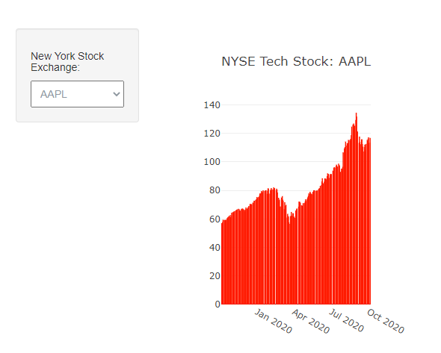
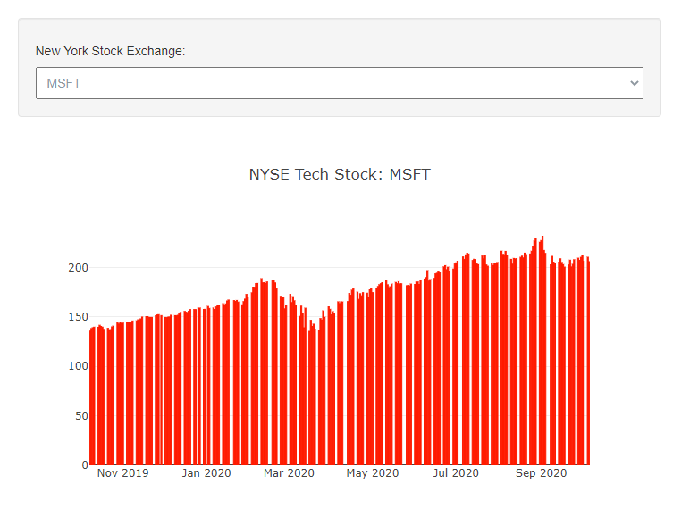
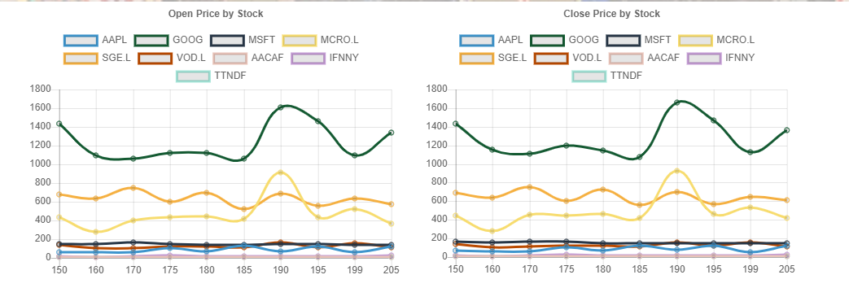

Slide 8
Challenges
RESTFUL API would not deploy due to a missing app route. (also Date formatting issues)
Discovering React would not work,
Choosing another library (Chartjs), after beginning the project
Chartjs install, outdated source code
Finding JS code to address formatting issues on our dashboard,(i.e. for Loops)
Console log issues: CORs, 404 errors, cache, etc.
Stalled, loading times
Plotly formatting, (i.e. changing colors)

Slide 9
Reflection
Data
Yahoo Finance is a great resource
Process
Task delegation. Finding
Clarified the direction of design before coding
More time
Use React Library to incorporate summary tables
Clean up webpage design
More data filters

